Slide 1
Cyber Security Forensic
By Xzavier Carter and Johanson Pierre

Slide 2
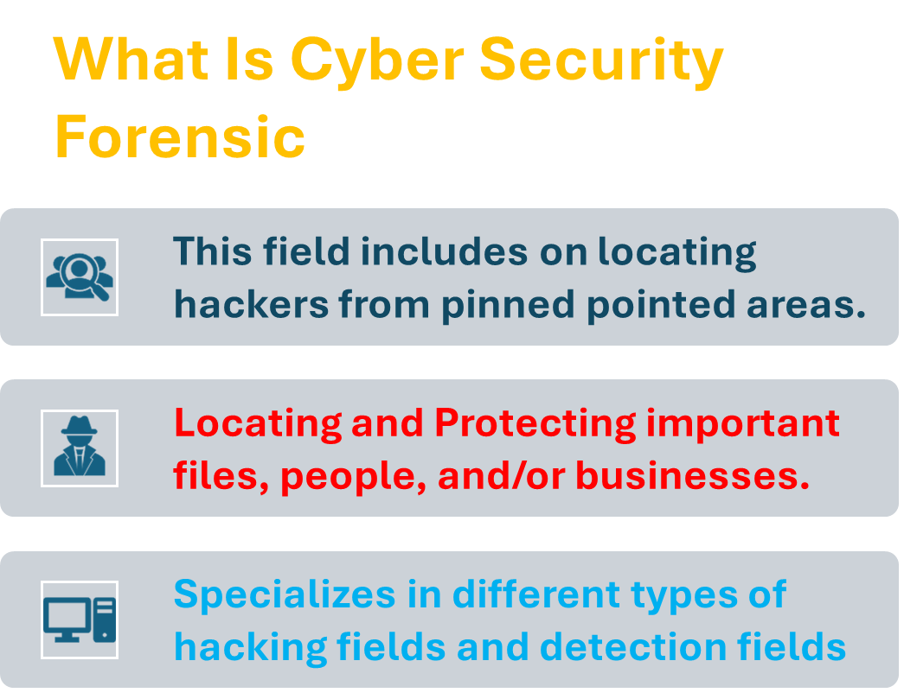


Slide 3
Their Main Roles During The Scene
Step 1 Secure
Protect from harm
Step 2 Examination/Collect
Inspect closely
Step 3 Analyze
Break down and study
Step 4 Report
Document findings

Slide 4
SolarWinds Case
1:23-CV-09518
The SolarWinds was comprised by a group of unknown hackers.
The SolarWinds company was tricked by using a technique known as supply chain compromise.
The SolarWinds attack was a complex case that required a multifaceted approach from cybersecurity forensics experts.
Step 1:Identify the compromise
Step 2:Analyze the malware
Step 3:Trace the attack path
Step 4:Recover and analyze data
Step 5:Build a timeline
Step 6:Share information
Step 1:Target a supplier
Step 2:Compromise the supplier
Step 3:Modify software
Step 4:Distribute the modified software
Step 5: Backdoor access

Slide 5
HOW MUCH DO THEY MAKE
Requirements
Certifications
$50,000 – $70,000
Bachelor Degree
$60,000 - $80,000
Master Degree
$80,000 –$120,000

Slide 6
ARE WE INTRESTED
PROS
CONS
Intellectual stimulation
Meaningful work
Career advancement
Diverse career paths
Competitive compensation
High stress
Long hours
Continuous learning
Ethical dilemmas
Work-life balance challenges

Slide 7
Questions
Question 1
Question 2
What is the minimum education level to work in cyber security forensic?
Online Certifications
Bachelor Degree
Master Degree
Doctoral Degree
What's the lowest salary starting pay in cyber security forensic?
40,000
60,000
50,000
70,000

